Slide 1
I/S Manager Meeting
August 6, 2015

Slide 2
Agenda
Welcome
Tim Gies
Summer Internships
Paul Lee
H1B Visa and Green Card Processing
Karen Gontarek
Direct Data Changes
Sheila Stanek
Q&A

Slide 3
Summer Internships
Paul Lee

Slide 4
Summer Internships
Agent App
Condensing internal app store
Our First App
Create new policies, new claims, uploads
Uploads include an image and a comment attached to a policy or claim
Does not access customer data or change customer data
(Uses our backend)

Slide 5
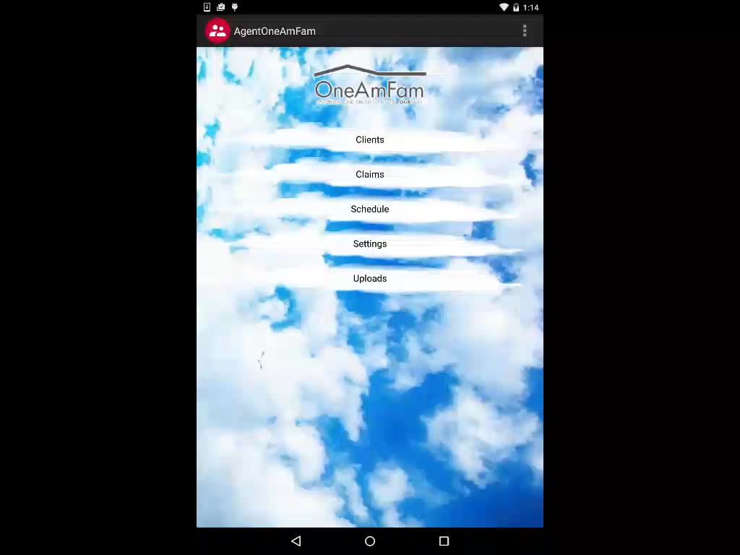
Clients

Slide 6

Claims

Slide 7

Schedule

Slide 8

Settings/Uploads

Slide 9
Summer Internships
Customer App
Customer Facing Android application
Gives the customer variety of features
Combines existing apps into a multi tool
Ex. Upload
Needs to feel “crisp and clean” so customer’s choose our app
Good user experience can make or break a project.

Slide 10
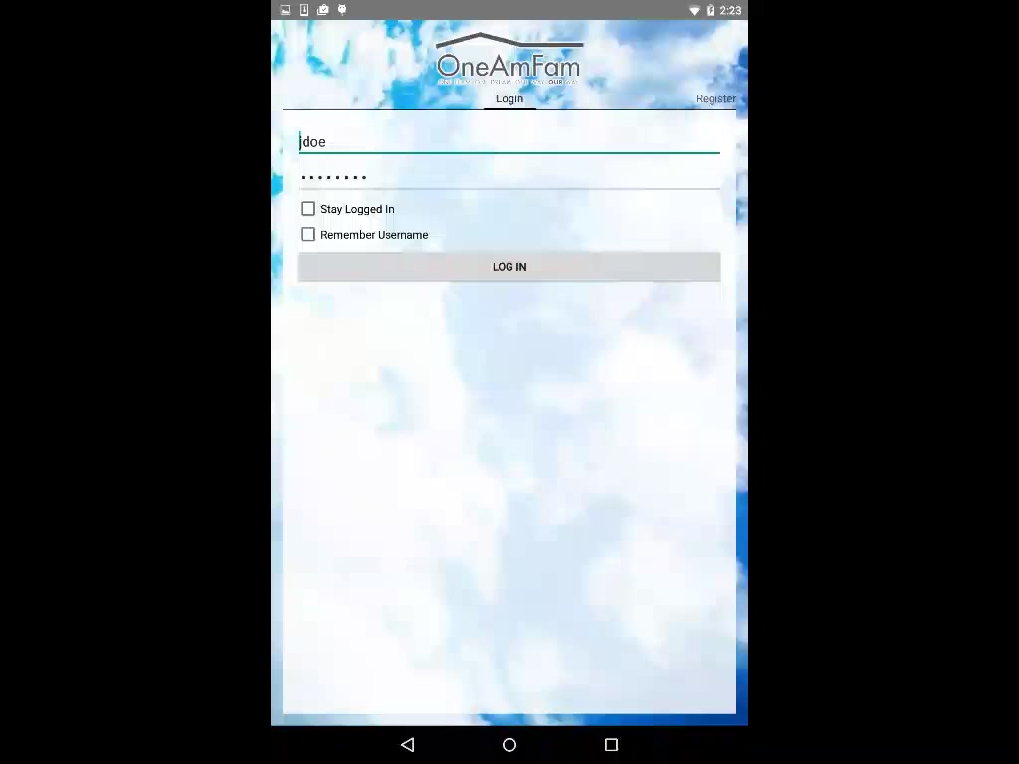
Log In/Register

Slide 11
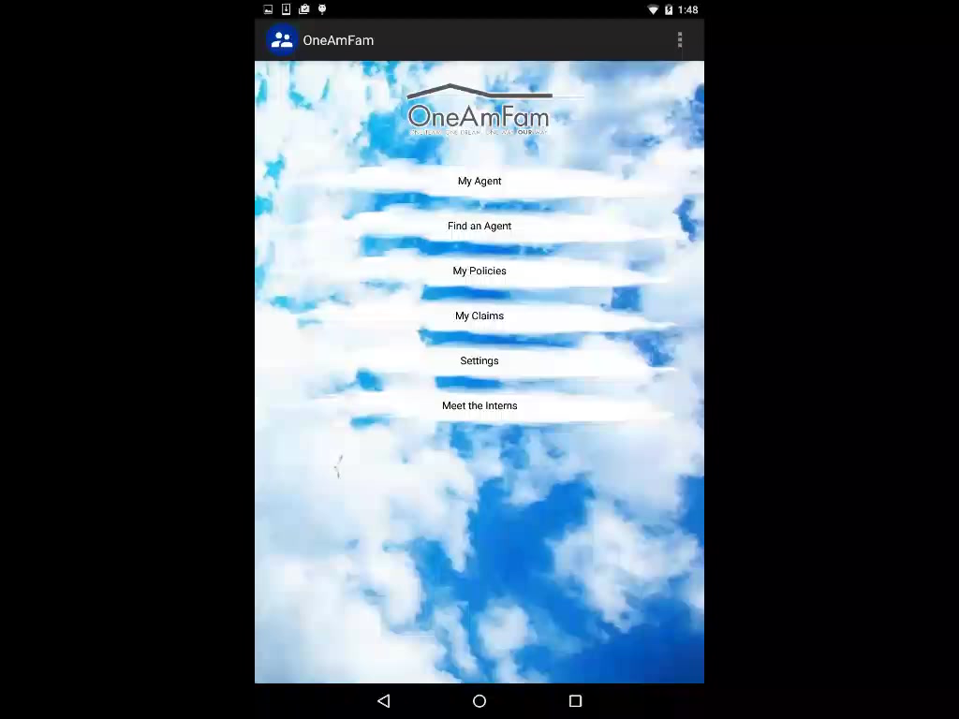
My Agent/Find an Agent

Slide 12

My Policies

Slide 13

My Claims

Slide 14

Meet the Interns Page

Slide 15
H1B Visa and Green Card Processing
Karen Gontarek

Slide 16
Direct Data Changes
Sheila Stanek

Slide 17
Q & A

Slide 18
Next Facilitators:
Pete Summers / Gary Gruber
September 3, 2015 meeting

Slide 19
Thank you!

